Slide 1



Relatrio Criativo
View in Power BI
Last data refresh:
18/07/2023 07:31:12 UTC
Downloaded at:
18/07/2023 08:11:10 UTC

Slide 2
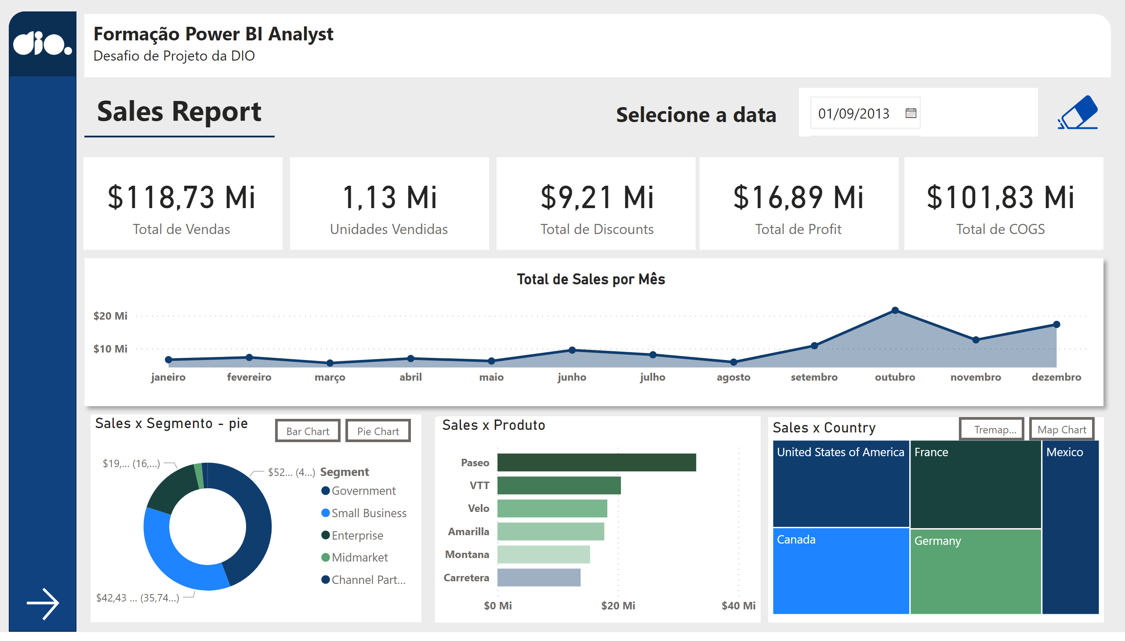
Página 1
Notes:
shape
No alt text provided
shape
No alt text provided
logo_dio
No alt text provided
shape
No alt text provided
textbox
No alt text provided
card
No alt text provided
card
No alt text provided
card
No alt text provided
card
No alt text provided
card
No alt text provided
shape
No alt text provided
shape
No alt text provided
shape
No alt text provided
shape
No alt text provided
shape
No alt text provided
textbox
No alt text provided
shape
No alt text provided
shape
No alt text provided
Botão - bar
No alt text provided
shape
No alt text provided
shape
No alt text provided
clean
No alt text provided
actionButton
No alt text provided
textbox
No alt text provided
actionButton
No alt text provided
Botão - map
No alt text provided
Botão - tremap
No alt text provided
Botão -pie
No alt text provided
clusteredBarChart
No alt text provided
Sales x Segmento - pie
No alt text provided
slicer
No alt text provided
Sales x Country
No alt text provided
areaChart
No alt text provided
Sales x Produto
No alt text provided
Sales x Country
No alt text provided

Slide 3
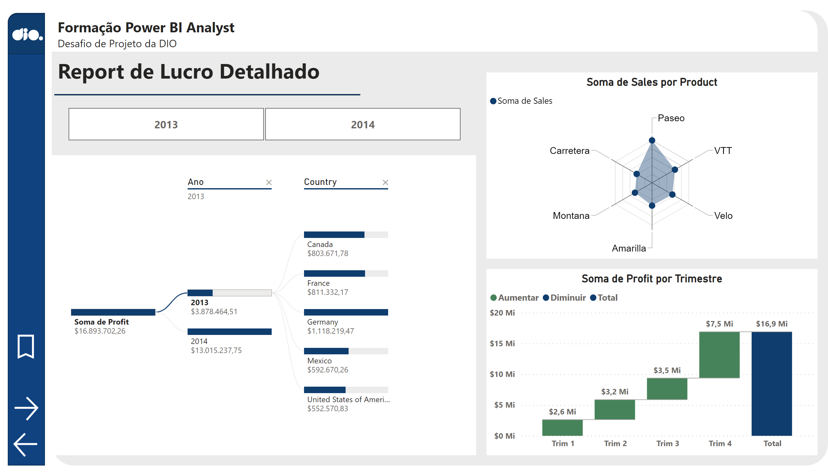
Página 2
Notes:
shape
No alt text provided
shape
No alt text provided
shape
No alt text provided
image
No alt text provided
Fundo do Título
No alt text provided
Título do report
No alt text provided
shape
No alt text provided
actionButton
No alt text provided
textbox
No alt text provided
shape
No alt text provided
actionButton
No alt text provided
actionButton
No alt text provided
waterfallChart
No alt text provided
slicer
No alt text provided
RadarChart1446119667547
No alt text provided
decompositionTreeVisual
No alt text provided

Slide 4
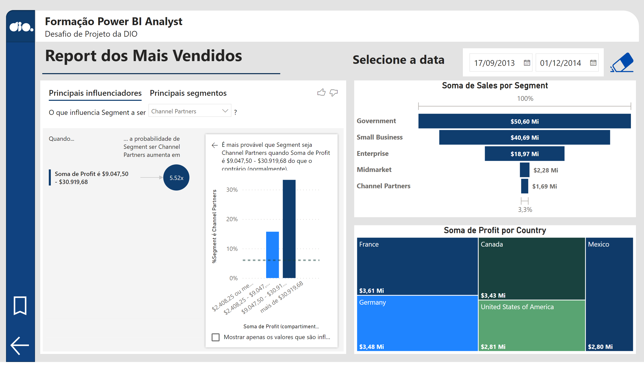
Página 3
Notes:
shape
No alt text provided
shape
No alt text provided
image
No alt text provided
Fundo do Título
No alt text provided
Título do report
No alt text provided
keyDriversVisual
No alt text provided
actionButton
No alt text provided
textbox
No alt text provided
clean
No alt text provided
actionButton
No alt text provided
textbox
No alt text provided
shape
No alt text provided
actionButton
No alt text provided
slicer
No alt text provided
funnel
No alt text provided
treemap
No alt text provided

